Slide 1

Seasonal Agriculture Performance Analysis
Shamika Anirudha Prabhu
Viva Institute of Technology, Virar
AICTE STU ID : STU6a57955741deb1784124759

Slide 2

PROBLEM STATEMENT
Agricultural activities are influenced by seasonal variations in environmental conditions, farming practices, resource availability and market conditions. As a result, agricultural performance may differ from one season to another. However, raw agricultural data does not clearly explain how agricultural performance changes across seasons or what patterns can be observed in different seasonal conditions. The problem is to analyze the given agricultural dataset and investigate seasonal differences in agricultural performance by identifying meaningful patterns, trends, relationships and variations within the available data.

Slide 3
Project Description
This project analyzes 4,000 farm-level records spanning the Kharif, Rabi and Zaid seasons across 8 Indian states to understand how agricultural performance changes with the season.
Using Python, the dataset is cleaned (season-and-crop-aware median imputation for missing values), explored through univariate, bivariate and multivariate visualizations, and tested statistically with ANOVA and Tukey's HSD to confirm which seasonal differences are real rather than visual noise.
The result is a set of evidence-based insights and recommendations for seasonal agricultural planning - covering yield, profitability, resource use, and disease/pest risk.

Slide 4

WHO ARE THE END USERS?
Agricultural policy planners deciding seasonal support programs
State agriculture departments issuing crop and disease advisories
Farmer-facing organizations and cooperatives advising on irrigation and crop choice
Agri-fintech / insurance providers assessing seasonal risk
Researchers and students studying seasonal agricultural patterns in India

Slide 5

Technology Used
Python
Pandas & NumPy - data cleaning, aggregation, feature engineering
Matplotlib & Seaborn - univariate, bivariate & multivariate visualization
SciPy - one-way ANOVA significance testing
Statsmodels - Tukey HSD post-hoc testing
Jupyter Notebook - documented, reproducible analysis

Slide 6
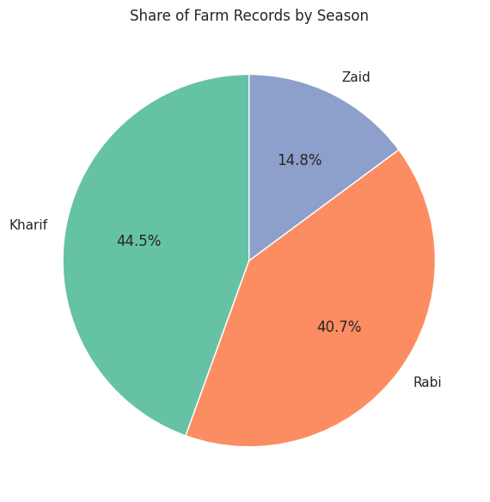
RESULTS
Dataset Overview
4,000 records across 3 seasons
Kharif 44.5% | Rabi 40.7% | Zaid 14.8%
Balanced enough for fair seasonal comparison

Slide 7
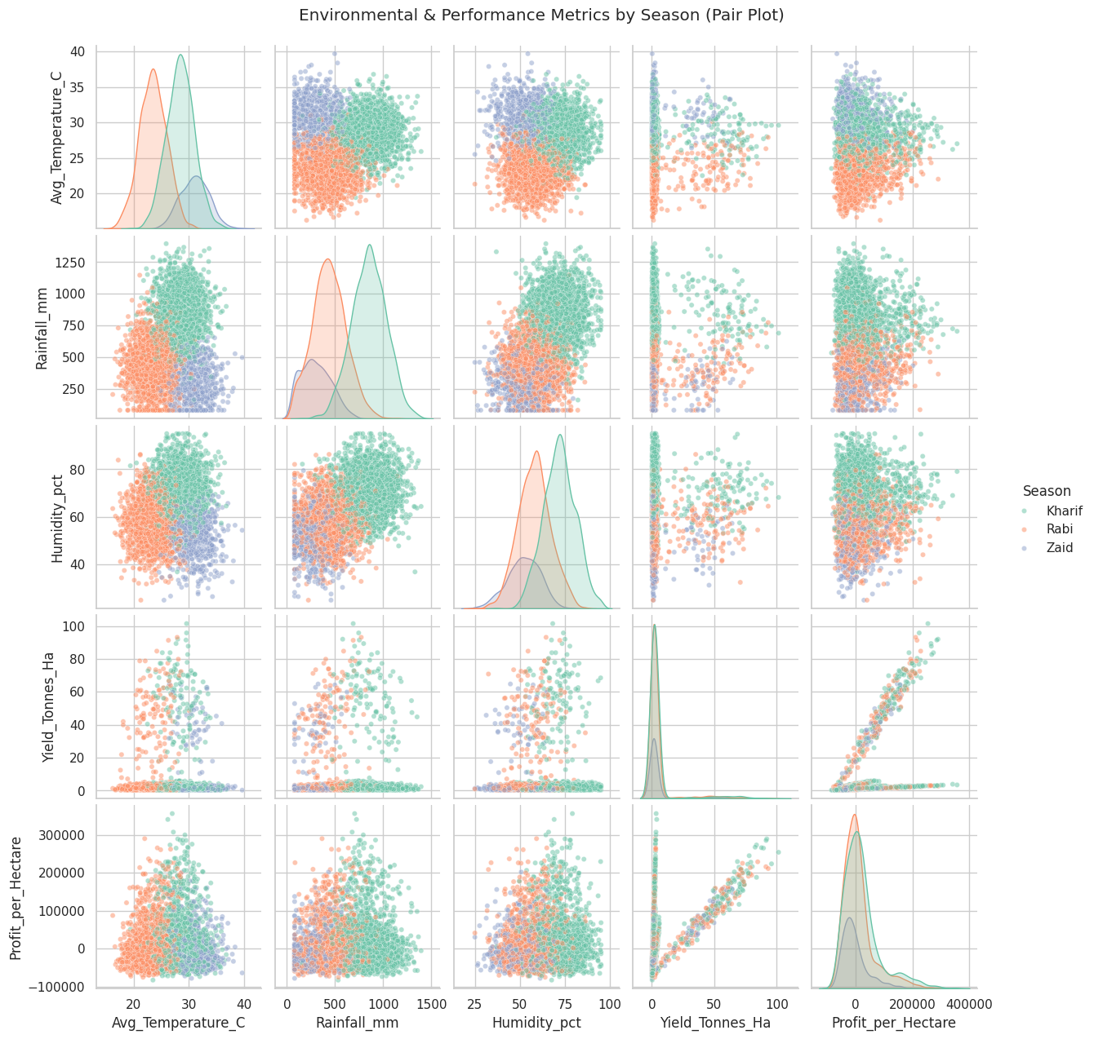
RESULTS
Environmental Seasonality
Temperature, rainfall & humidity visibly separate by season
Confirms seasons are environmentally distinct in this data
Yield & profit overlap heavily across seasons (see next slide)

Slide 8
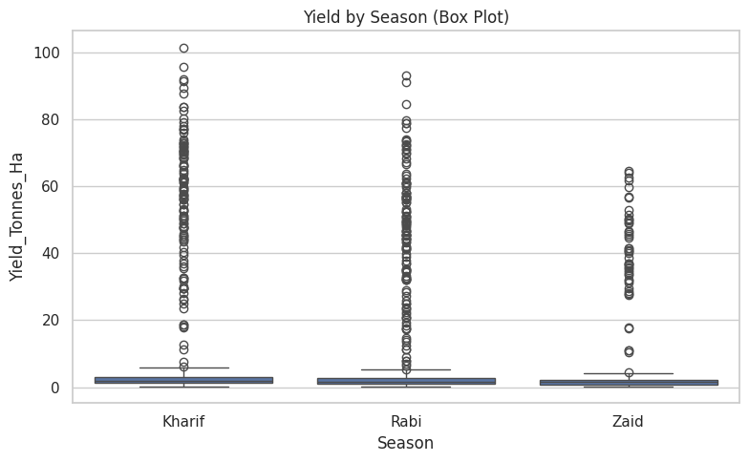
RESULTS
Yield by Season
Kharif highest avg yield, Zaid lowest - but ANOVA p = 0.23
NOT statistically significant
Within-season variability outweighs the season-to-season gap

Slide 9
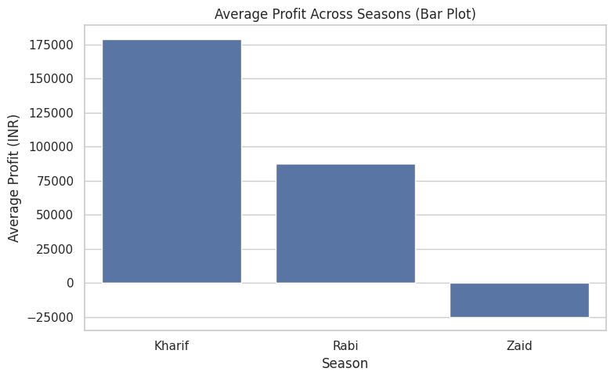
RESULTS
Profit by Season
ANOVA p < 0.001 - statistically significant
Tukey HSD: every season pair differs significantly
Zaid runs at an average LOSS despite similar yield -> a price/cost effect

Slide 10
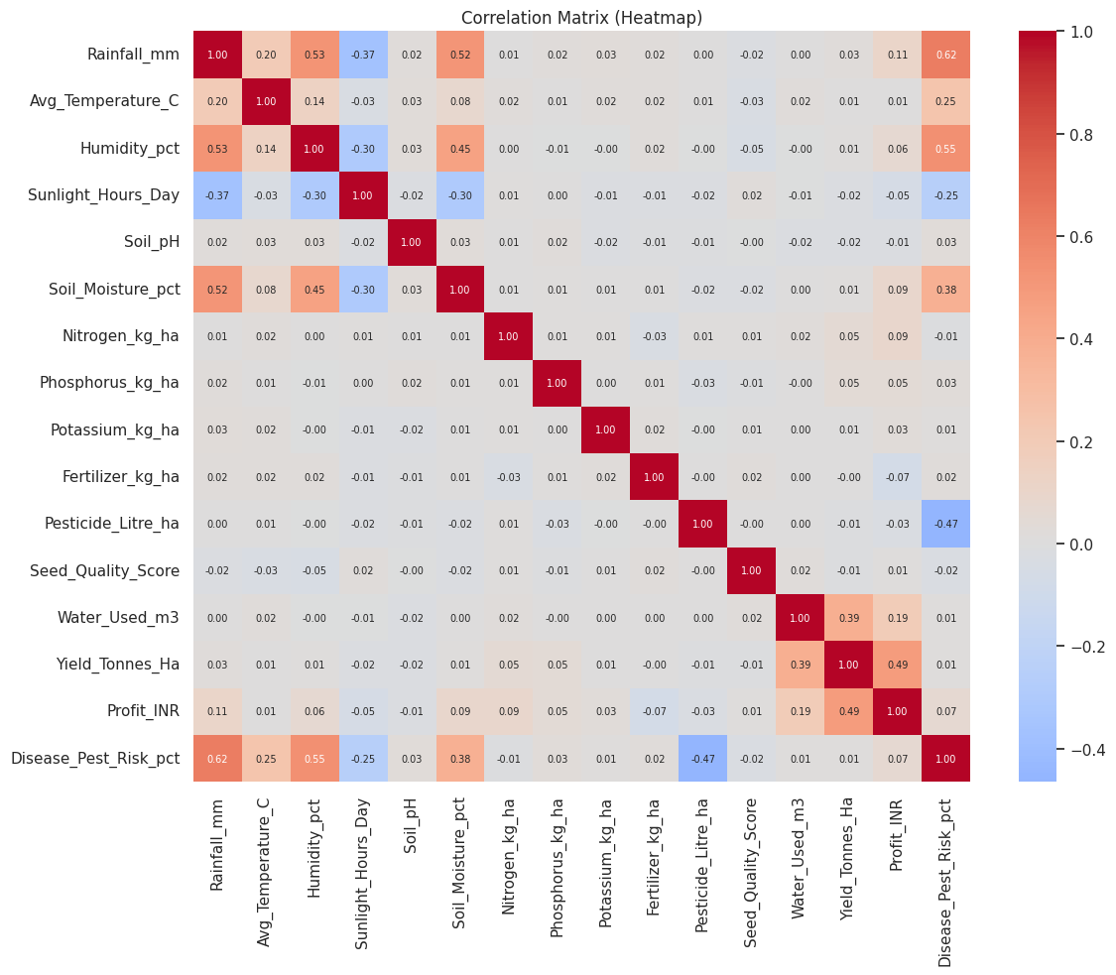
RESULTS
Correlation Analysis
Profit correlates more with Yield (r=0.49) than any single weather variable
Disease/Pest risk correlates strongly with Rainfall (r=0.62) & Humidity (r=0.55)
Fertilizer/Pesticide show negligible correlation with yield in this data

Slide 11
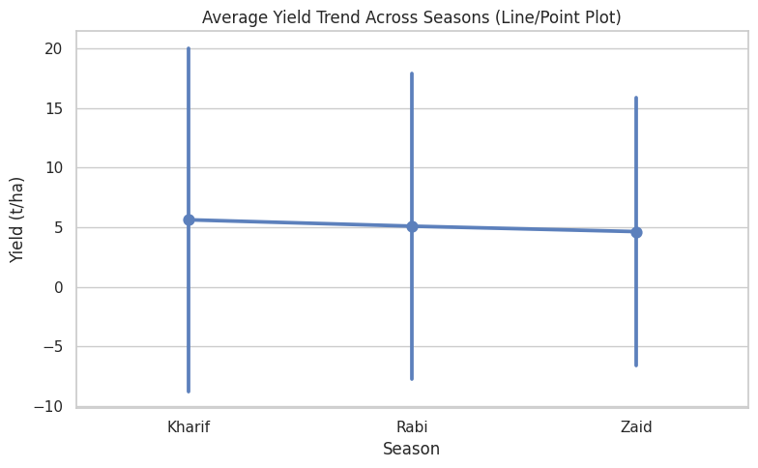
RESULTS
Yield Trend Across Seasons
Point plot with +/-1 SD error bars for average yield per season
Kharif, Rabi and Zaid means sit close together and the error bars overlap heavily
Visually confirms the ANOVA result: yield is not significantly season-dependent

Slide 12
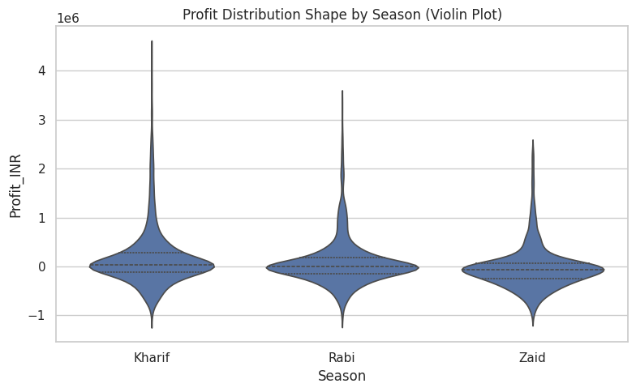
RESULTS
Profit Distribution Shape
Violin plot shows the full shape of profit, not just the season average
Zaid's distribution sits lowest and dips below zero, matching its average loss
Kharif and Rabi show wider, higher-value spreads with longer tails

Slide 13
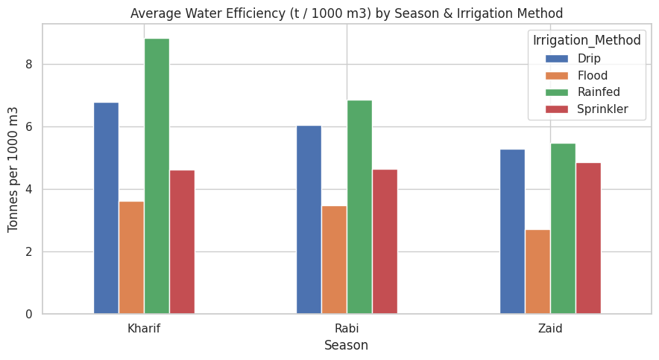
RESULTS
Water Efficiency by Irrigation Method
Rainfed farming is most water-efficient in every season (8.85 -> 6.87 -> 5.48 t/1000m3)
Flood irrigation stays least efficient across Kharif, Rabi and Zaid alike
The irrigation ranking doesn't flip by season, but efficiency falls for every method into Zaid

Slide 14
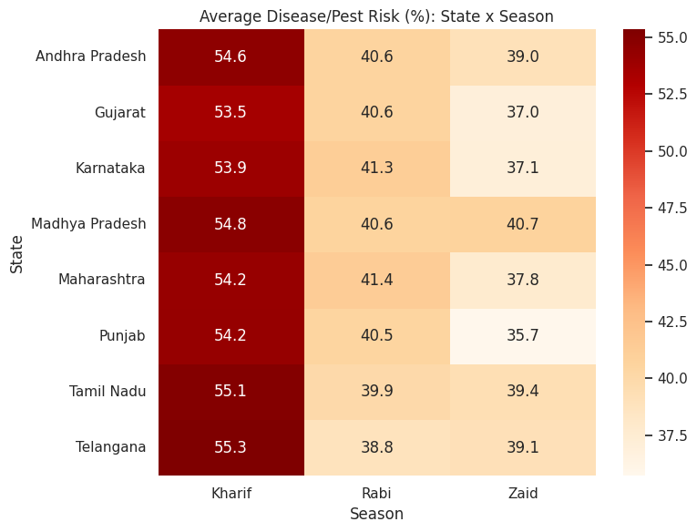
RESULTS
Disease/Pest Risk by State
Risk is fairly uniform across all 8 states within a season (Kharif: 53.5-55.3%)
Kharif carries the highest risk everywhere; Zaid the lowest and most variable (35.7-40.7%)
The seasonal effect dominates over regional differences - a season-based advisory works nationwide

Slide 15
Future scope
Extend the dataset to multiple years to confirm whether the yield result (not significant in this single-cycle sample) holds or changes with more data
Bring in district-level market price data to explain Zaid's profit loss more precisely
Add satellite/weather-station data for finer-grained rainfall and soil-moisture readings
Build a season-aware advisory tool for irrigation-method selection using these findings
Explore crop-specific seasonal models rather than one model across all crops

Slide 16
GitHub Link
https: https://github.com/Shamika2231/Seasonal-Agriculture-Performance-Analysis

Slide 17
VOIS Course completion certificate -
Course name- Data Visualization

Slide 18
Thank you
.
.

